Slide 1



Integrated Sensing
and Communication
group 7:
陈胤举、周慧斌、宋毅飞、陈根文、陈治霖
date：2024.12.22

Slide 2
目
CONTENTS
录
01
Introduction
02
Research Purpose
03
System model design
04
Research methods
05
Expected Work Goals

Slide 3

General
Introduction
Part
01

Slide 4

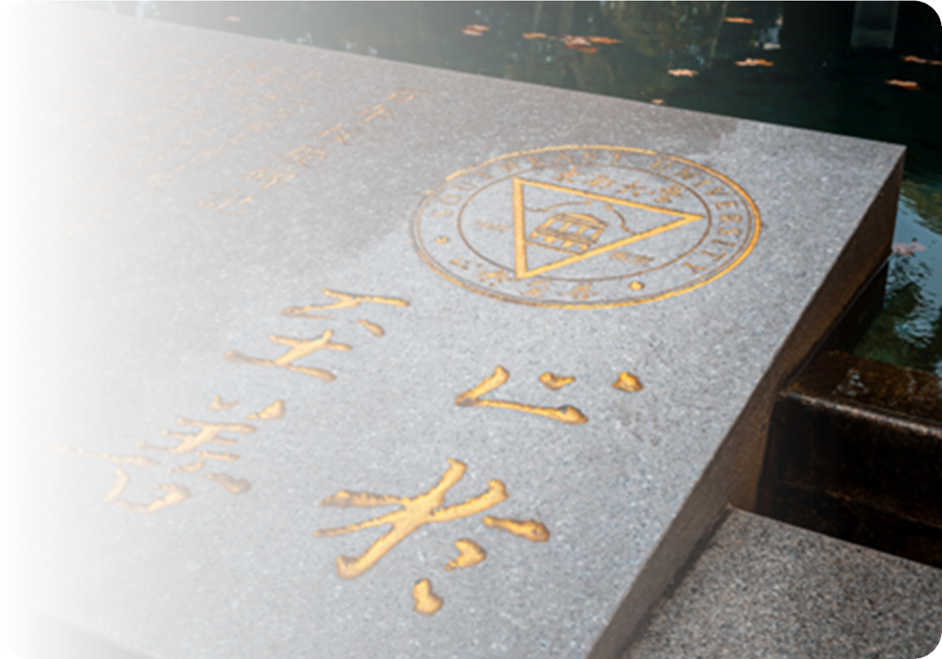
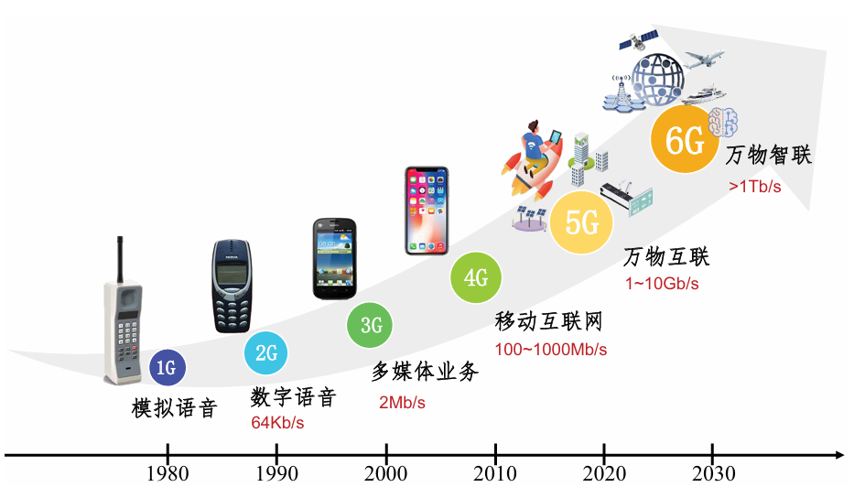
Research Background
According to the law of the change of mobile communication in the decade, the industry has shifted its focus to the commercialization of 5G.
In the past few decades, mobile communication has achieved a leap from 1G to 5G..
5G extends the application scenario to the field of Internet of Things. it is committed to building an information society of ' Internet of Everything '

Slide 5

Edge Intelligence
mobile edge computing(MEC)
sink the resources, storage and computing capabilities of the cloud computing center to the network edge.
Overview
of
edge
intelligence
artificial intelligence(AI)
AI is an important branch of computer science. It refers to mining from massive data when a machine performs a specific task.
edge intelligence(EI)
The combination of MEC and AI is inevitable, because there is a clear intersection between them, which gives birth to edge intelligence.

Slide 6
Integration
Communication and Computing
The integration of communication and computing refers to the combination of communication technology and computing technology.
Integration
Of
Communication
Sensing
computing
Communication and Sensing
The integration of communication and sensing is the core technology to realize the integration of communication and computing.
Sensing and Computing
Integration of perception and computation will be with more accurate and efficient data processing and decision-making capabilities.

Slide 7
Research Purpose and Significance
Part
02
Research Purpose
Research Significance

Slide 8
Research Purpose and Significance
Collaborative Operation and Resource Sharing
Investigating how sensing and communication systems can work synergistically to achieve resource sharing and performance optimization.
Design of a Novel System Architecture
Exploring its advantages in efficient spectrum utilization, system capacity enhancement, and real-time sensing through theoretical modeling.
Research Purpose
Technology Solutions for Future Networks
Proposing sensing and communication technology solutions that meet the needs of future networks.

Slide 9

Research Purpose and Significance
Research Significance
Enhancing System Performance
Saving Spectrum Resources
Promoting Intelligent Development
Expanding Application Fields

Slide 10
Research Purpose and Significance
Research Significance
Enhancing System Performance
Saving Spectrum Resources
Promoting Intelligent Development
Expanding Application Fields
By sharing sensing and communication resources, the system can achieve more efficient data transmission, signal processing, and spectrum utilization.

Slide 11
Research Purpose and Significance
Research Significance
Enhancing System Performance
Saving Spectrum Resources
Promoting Intelligent Development
Expanding Application Fields
Improving the capacity, latency, and reliability of communication systems.
Share spectrum resources, reduce redundant overhead, and improve spectrum utilization efficiency.

Slide 12
Research Purpose and Significance
Research Significance
Enhancing System Performance
Saving Spectrum Resources
Promoting Intelligent Development
Expanding Application Fields
Improving the capacity, latency, and reliability of communication systems.
Share spectrum resources, reduce redundant overhead, and improve spectrum utilization efficiency.
Provide data support for adaptive scheduling and intelligent decision-making in wireless networks through precise sensing and analysis of real-time data.

Slide 13
Research Purpose and Significance
Research Significance
Enhancing System Performance
Saving Spectrum Resources
Promoting Intelligent Development
Expanding Application Fields
Improving the capacity, latency, and reliability of communication systems.
Share spectrum resources, reduce redundant overhead, and improve spectrum utilization efficiency.
Provide data support for adaptive scheduling and intelligent decision-making in wireless networks through precise sensing and analysis of real-time data.
Broad application prospects in fields such as autonomous driving, intelligent transportation, and environmental monitoring.

Slide 14
System model design
Part
03
ISAC for sensing
ISAC for communication

Slide 15

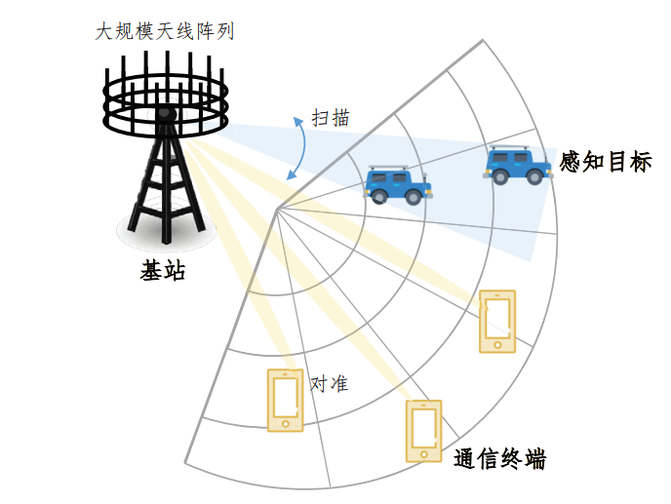

system model design
Integrated Sensing and Communication (ISAC) originated from the development and integration of radar and communication technologies.
MIMO technology has promoted the development of ISAC. MIMO is a wireless communication technology that uses multiple transmitting and receiving antennas to improve data transmission rate and communication quality.
What is ISAC?
MIMO
radar
sensing
Increased the communication rate.
Improved performance of communication system.
MIMO technology
communication
high-precision and high-resolution of wireless sensing capability.
multi-path!
Notes:
what is Integrated Sensing and Communication（ISAC）？ it is originated from the development and integration of radar and communication technologies.
Radar is used to detect targets, obtain information such as their distance and speed, then classify and track targets. Communication and sensing are originally two different theoretical systems\
however, The emergence of mimo technology allows the two theories to be integrated into a whole system. what is mimo? mimo is
Imagine that two devices originally had only one path to connect to each other for independent communication or sensing . Now, using MIMO technology, multiple paths can be used to establish connections at the same time, so that some paths can be used for communication and perception respectively.
by using mimo technology,

Slide 16
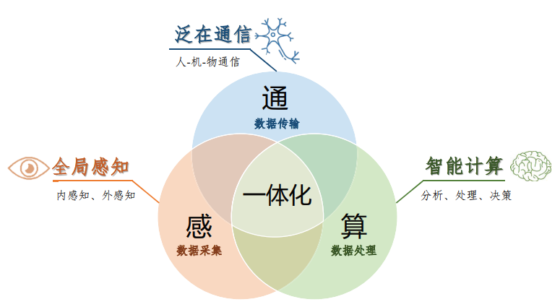
system model design
communication
Communication
The ability for people and devices to transfer message and interact with each other through wireless networks.
sensing
computing
Sensing
Including the perception of the position, distance, speed of a single target, as well as the detection, recognition, and imaging of the target.
Deeply integrated system
Computing
Commucation, Sensing and Computing deeply integrated, each function can support and promote each other.
The ability of devices and servers to process and analyze data using algorithms and AI models
Notes:
ISAC is the integrated system of communication , sensing, and computing is used to ensure each functions to get better performance
In this system, communication means...
there are two main ways to realize Integrated Sensing and Communication（ISAC）

Slide 17
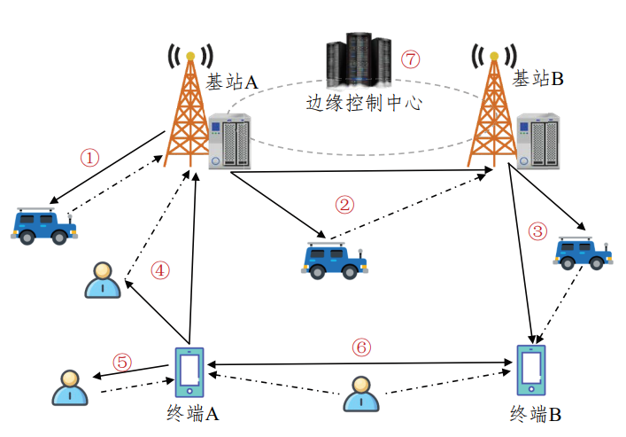
system model design
two models:
user3
user1
user4
communication
device
user2
ISAC for Sensing (communication promotes Sensing)
ISAC for Communication (Sensing-assisted Communication)
Notes:
the first system model is ISAC for Sensing (communication promotes Sensing),
the second model is ISAC for Communication (Sensing-assisted Communication).
Next, i will introduce two models respectively.

Slide 18
system model design
model one:
user3
user1
Sensing with Communication Signals, Using the Same Device for Both functions
1、Reduce System Cost and Complexity
2、Improve Sensing Accuracy
3、Real-Time Sensing
user4
communication
device
user2
ISAC for Sensing (communication promotes Sensing)
Notes:
一：in the model of ISAC for Sensing (communication promotes Sensing), this means perform sensing with Communication Signals, in this way the same device is cable for both sensing and commucation.
so the System Cost and Complexity is reduced. what is more, because of the instant communication capability and large bandwidth of the communication system, the hign-accuracy sensing and real time sensing is obtained.

Slide 19
system model design
model two:
Sensing the Target's Position and Velocity to Align the Communication Beam with the User
1、Enhance Communication Quality
2、Optimize Resource Allocation
3、Reduce the Impact of Interference
ISAC for Communication (Sensing-assisted Communication)
Notes:
二：the second model is ISAC for Communication (Sensing-assisted Communication). this includes Sensing the Target's Position and Velocity to Align the Communication Beam with the User
By locating and tracking the target through sensing, the communication beam is directly stick to the target user, thus achieving

Slide 20
Research methods and roadmap
Part
04
ISAC for sensing
ISAC for communication

Slide 21

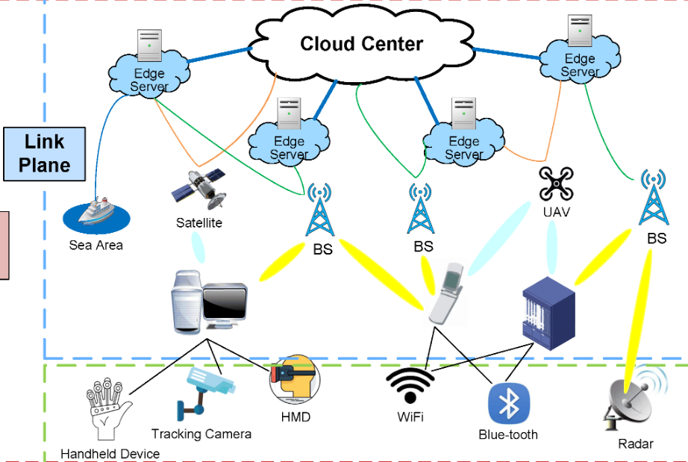
Research methods
Research methods
Theoretical framework
Algorithm design
System simulation
Experimental validation
System Architecture of ISAC (Integrated Sensing and Communication)
Notes:
二：the second model is ISAC for Communication (Sensing-assisted Communication). this includes Sensing the Target's Position and Velocity to Align the Communication Beam with the User
By locating and tracking the target through sensing, the communication beam is directly stick to the target user, thus achieving

Slide 22
Research methods
Theoretical framework
Analyze the relationship between transmission rate and resource usage.
Algorithm design
Explore machine learning for waveform design and resource allocation.
System simulation
Research methods
Construct different communication scenarios.
Four key aspects
Experimental validation
Employ a software-defined radio (SDR) platform.

Slide 23
Research roadmap
Research roadmap
Foundational study
Algorithm development
Experimental simulation
Report writing

Slide 24
Research roadmap
Research roadmap
Foundational study
Algorithm development
Experimental simulation
Report writing
Define the research objective clearly.
(wireless communication, sensing technologies, optimization methodologies)

Slide 25
Research roadmap
Research roadmap
Foundational study
Algorithm development
Experimental simulation
Report writing
Define the research objective clearly.
(wireless communication, sensing technologies, optimization methodologies)
Designing machine learning-based waveform design and resource allocation methods.

Slide 26
Research roadmap
Research roadmap
Foundational study
Algorithm development
Experimental simulation
Report writing
Define the research objective clearly.
(wireless communication, sensing technologies, optimization methodologies)
Validate the effectiveness of the proposed methods through simulations conducted on platforms such as MATLAB.
Designing machine learning-based waveform design and resource allocation methods.

Slide 27
Research roadmap
Research roadmap
Foundational study
Algorithm development
Experimental simulation
Report writing
Define the research objective clearly.
(wireless communication, sensing technologies, optimization methodologies)
Validate the effectiveness of the proposed methods through simulations conducted on platforms such as MATLAB.
Designing machine learning-based waveform design and resource allocation methods.
Consolidate our findings and compile the research outcomes into a comprehensive report.

Slide 28
Expected Work Goals
Part
05
Key Words:
Integrated model
Communication
Target Sensing
Model Computation

Slide 29
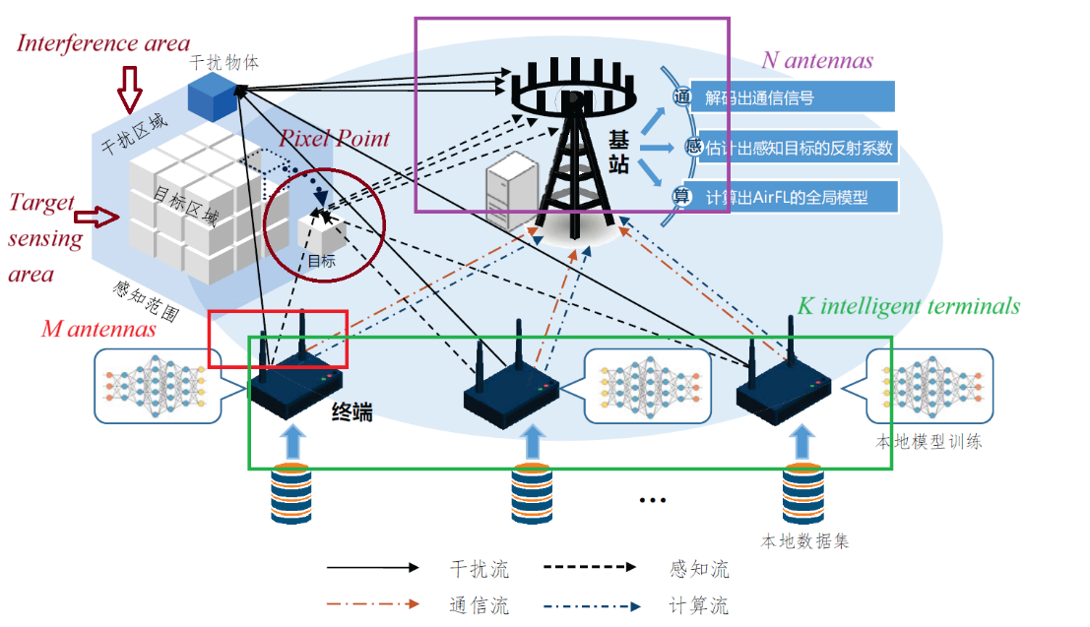
Expected Work Goals
Communication
Multifunctional Integrated Model
Target Sensing
Model Computation

Slide 30

Expected Work Goals

Slide 31
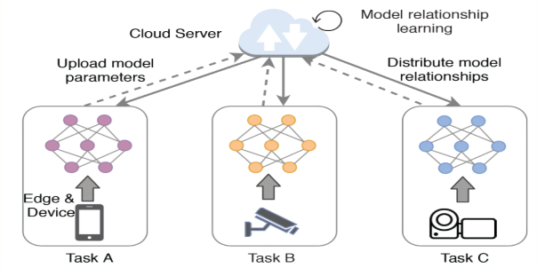
Expected Work Goals
Communication Signals
(Transmitted by the intelligent terminals)
COMMUNICATION
Communication
Receiver
Obtain the desired
communication data
Reflected Signals
(Contain environmental information)
TARGET
SENSING
Sensing
Receiver
Estimate the target’s reflection coefficients
MODEL
COMPUTATION
Computation
Receiver
Obtain a
global model

Slide 32
Expected Work Goals
Communication Signals
(Transmitted by the intelligent terminals)
COMMUNICATION
Communication
Receiver
Obtain the desired
communication data
Reflected Signals
(Contain environmental information)
TARGET
SENSING
Sensing
Receiver
Estimate the target’s reflection coefficients
MODEL
COMPUTATION
Computation
Receiver
Obtain a
global model

Slide 33
Expected Work Goals
Communication Signals
(Transmitted by the intelligent terminals)
COMMUNICATION
Communication
Receiver
Obtain the desired
communication data
Reflected Signals
(Contain environmental information)
TARGET
SENSING
Sensing
Receiver
Estimate the target’s reflection coefficients
MODEL
COMPUTATION
Computation
Receiver
Obtain a
global model

Slide 34
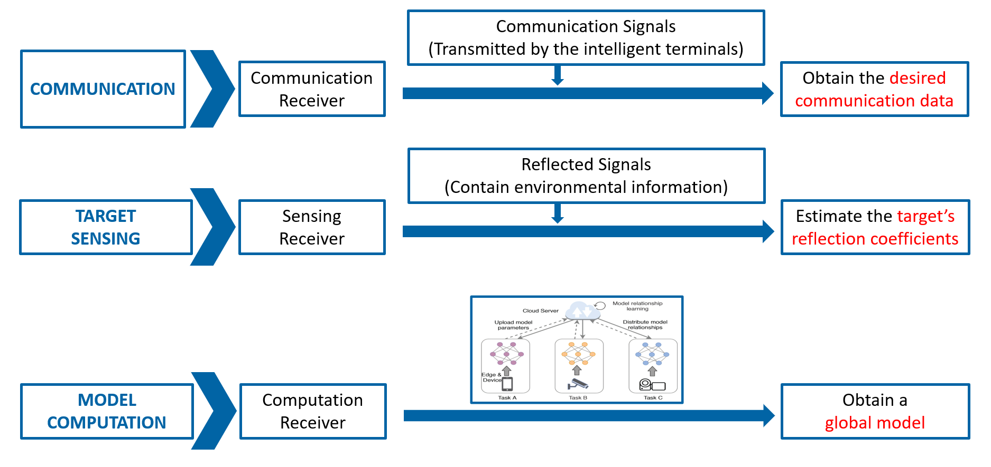
Expected Work Goals
THEORY
Enhance the Communication Performance:
communication speed, latency, utilization, etc.
PRACTICE
Make a real Impact in Real World:
intelligent transportation, IoT, etc.

Slide 35
Thank you for listening!
group 7:
陈胤举、周慧斌、宋毅飞、陈根文、陈治霖
date：2024.12.22

